Slide 1
POSTOPERATIVE COMPLICATION
Done by: Fadel Moh.tariq

Slide 2
Post-operative complications may either be general or specific to the type of surgery undertaken, and should be managed with the patient's history in mind.
The highest incidence of post-operative complications is between 1 and 3 days after the operation.

Slide 3
General postoperative complication
Common:
post-operative fever
Atelectasis
wound infection
Embolism
Deep vein thrombosis

Slide 4
General postoperative complication
Immediate
Primary haemorrhage: either starting during surgery or following post-operative increase in blood pressure
Basal atelectasis: minor lung collapse.
Shock: blood loss,acute myocardial infarction, pulmonary embolism or septicaemia.
Low urine output: inadequate fluid replacement intra- and post-operatively.

Slide 5
General postoperative complication
Early
Acute confusion: exclude dehydration and sepsis
Nausea and vomiting: analgesia or anesthetic-related, paralytic ileus
Fever
Secondary haemorrhage: often as a result of infection
Pneumonia
Wound or anastomosis dehiscence
Deep vein thrombosis (DVT)
Acute urinary retention
Urinary tract infection (UTI)
Post-operative wound infection
Bowel obstruction due to fibrinous adhesions
Paralytic Ileus

Slide 6
General postoperative complication
Late
Bowel obstruction due to fibrous adhesions
Incisional hernia
Persistent sinus
Recurrence of reason for surgery, e.g. malignancy

Slide 7
1.Respiratory complication
Atelectasis
Pneumonia
Aspiration
Pulmonary edema
Acute respiratory depression
Acute respiratory failure

Slide 8
A.Airway obestruction
Airway obstruction in unconscious patients is most commonly due to the tongue falling back against the posterior pharynx.
Other causes include laryngospasm; glottic edema; secretions, vomitus, or blood in the airway; or external pressure on the trachea.
characteristic ‘see-saw’ or paradoxical pattern of
ventilation.
perform a chin lift or jaw thrust

Slide 9
If the above maneuvers fail, laryngospasm should be considered.
high-pitched crowing noises but may be silent.
Spasm of the vocal cords is more apt to occur following airway trauma, or repeated instrumentation, or stimulation from secretions or blood in the airway. The jaw-thrust maneuver, particularly when combined with gentle positive airway pressure via a tight-fitting face mask, usually breaks laryngospasm.
Refractory laryngospasm ------> succinylcholine , 100% oxygen
Glottic edema following airway instrumentation is an important cause of airway obstruction in infants and young children Intravenous corticosteroids (dexamethasone, 0.5 mg/kg) or aerosolized racemic epinephrine

Slide 10
B.Hypoventilation
PaCO₂ greater than 45 mm Hg
clinically apparent only when the PaCO₂ is greater than 60 mm Hg or arterial blood pH is less than 7.25
Signs are varied and include excessive or prolonged somnolence, airway obstruction, slow respiratory rate, tachypnea with shallow breathing, or labored breathing. Mild to moderate respiratory acidosis causes tachycardia and hypertension or cardiac irritability (via sympathetic stimulation), but a more severe acidosis produces circulatory depression .
Causes: most commonly (Opioid)…. Inadequate reversal, overdose, hypothermia, pharmacological interactions .. metabolic factors …diaphragmatic dysfunction…. Increased CO₂ production from shivering, hyperthermia, or sepsis...
Treatment: underlying cause … endotracheal intubation.. naloxone

Slide 11
B.Hypoxemia
most important respiratory complication after anaesthesia and surgery. It may start at recovery and in some patients persist for 3 days ormore after surgery.
The presence of cyanosis is very insensitive and when detectable the arterial PO2 will be (55 mmHg), a saturation of 85%.
Causes : alveolar hypoventilation; V/Q mismatch within the lungs … diffusion hypoxia… pulmonary diffusion defects…ARDS…a reduced inspired oxygen concentration… postoperative pneumothorax .
TREATMENT: Oxygen therapy

Slide 12
2.Circulatory complication
Haemorrhage : Bleeding internally or externally.
Thrombus : Blood clot attached to wall of vein or artery (most commonly the leg veins).
Embolus :Clot that has moved from its site of formation to another area of the body.

Slide 13
A.Hypotension
can be due to a variety of factors, alone or in combination, that reduce the cardiac output,the systemic vascular resistance or both:
Hypovolaemia (most common) :Reduced peripheral perfusion, Tachycardia , Hypotension, Inadequate urine output (<0.5mL/kg/h),
reduced myocardial contractility :The commonest cause is ischaemic heart disease : poor peripheral circulation , tachycardia; tachypnoea , distended neck veins , basal crepitations, wheezez, triple rhythm on auscultation of the heart
Tx: sit patient upright,, O2 ,,, ECG
Vasodilatation: common during spinal or epidural anaesthesia , prostate surgery , septic shock …….Tx : administration of fluids , vasopressors(ephedrine). Antibiotic

Slide 14
cardiac arrhythmias:
Occur more frequently in the presence of: hypoxaemia; hypovolaemia hypercarbia; hypothermia; sepsis; pre-existing ischaemic heart disease; electrolyte abnormalities; hypo/hyperkalaemia, hypocalcaemia, hypomagnesaemia; acid–base disturbances;inotropes, antiarrhythmics, bronchodilators.
Coronary artery flow is dependent on diastolic pressur and time. Hypotension and tachycardia are therefore particularly dangerous.
Manegment : underlying problem
Sinus tachycardia : B-blocker
SVT : The most commonis atrial fibrillation→ amiodarone
Sinus bradycardia : atropin ,,, underlying causes

Slide 15
B.Hypertension
This is most common in patients with pre-existing
hypertension. It may be exacerbated or caused
by:
• Pain
• Hypoxaemia
• Hypercarbia
• Confusion or delirium
• Hypothermia.

Slide 16
C.arrhythmias

Slide 17
3.Urinary complication
Urinary retention:
  common immediate post-operative complication
  dealt with conservatively with adequate analgesia.
  catheterisation. (if fails)
UTI:
  very common (women)
  may not present with typical symptoms.
  Treat with antibiotics and adequate fluid intake.

Slide 18
Acute renal failure:
  May be caused by antibiotics, obstructive jaundice and surgery to the aorta
  Often due to episode of severe or prolonged hypotension
  Presents as low urine output with adequate hydration
The commonest cause of oliguria is hypovolaemia;
anuria is usually due to a blocked catheter.

Slide 19
4.Postoperative pain
pain is often manifested as postoperative restlessness
Should considered:
  Serious systemic disturbances (such as hypoxemia, acidosis, or hypotension)
  bladder distention
  surgical complication (such as occult intraabdominal hemorrhage)

Slide 20
Pain control
Moderate to severe postoperative pain in the PACU
  Meperidine 25-150 mg (0.25-0.5 mg/kg in children).
  Morphine 2-4 mg (0.025-0.05 mg/kg in children).
  C. Fentanyl 12.5-50 mcg IV.
Nonsteroidal anti-inflammatory drugs are an effective complement to opioids.
  Ketorolac 30 mg IV followed by 15 mg q6-8 hrs.
Patient-controlled and continuous epidural analgesia should be started in the PACU.

Slide 21
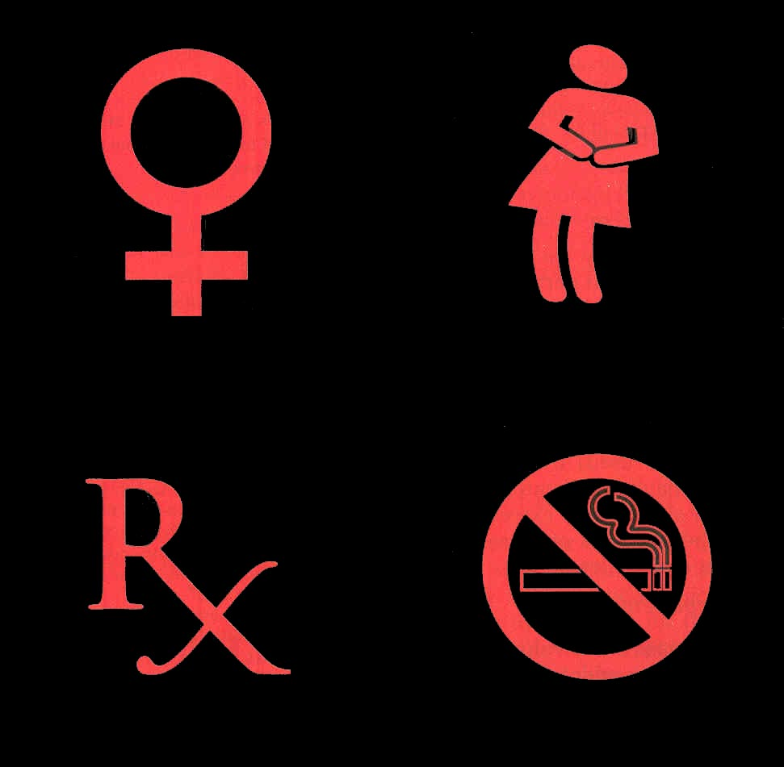
5.Postoperative Nausea And Vomiting
This occurs in up to 80% of patients following anaesthesia and surgery.
Age and sex : Female , children
Site of surgery: abdominal, middle ear or the posterior cranial fossa.
Anaesthetic drugs: etomidate, nitrous oxide.
Opioid
Gastric dilatation
Hypotension : epidural or spinal
Patients prone to travel sickness

Slide 22
Tratment :
Befor treatment it is essential to make sure that the patient is not hypoxaemic or hypotensive.
Antihistamines Cyclizine
5-HT3 (hydroxytryptamine) antagonists Ondansetron(Zofran).
Dopamine antagonists Metoclopramide
Phenothiazine derivatives Prochlorperazine (Stemetil).
• Anticholinergic drugs Atropine and hyoscine
Steroids Dexamethasone 8mg IV may be useful in resistant cases.

Slide 23
6. Shivering & Hypothermia
Shivering can occur in the PACU as a result of intraoperative hypothermia And associated with volatile anesthetic.
Shivering in such instances represents the body's effort to increase heat production and raise body temperature and may be associated with intense vasoconstriction.

Slide 24
The most important cause of hypothermia is
1.redistribution of heat from the body core to the peripheral compartments
2. cold temperature in the OR,
3. exposure of a large wound,
4. the use of large amounts of unwarmed intravenous fluids.
Nearly all anesthetics, particularly volatile agents, decrease the normal vasoconstrictive response to hypothermia.

Slide 25
Although anesthetic agents also decrease the shivering threshold.
Intense shivering : causes precipitous rises in oxygen consumption, CO2 production, and cardiac output.
Hypothermia : has been associated with an increased incidence of myocardial ischemia, arrhythmias, increased transfusion requirements, and increased duration of muscle relaxant

Slide 26
Management of shivering and Hypothermia
Hypothermia should be treated with :
a forced-air warming device,
(less satisfactorily) with warming lights or heating blankets, to raise body temperature to normal.
Small intravenous doses of meperidine, 10–50 mg, can dramatically reduce or even stop shivering

Slide 27
Thank you done by fadel

